Slide 1
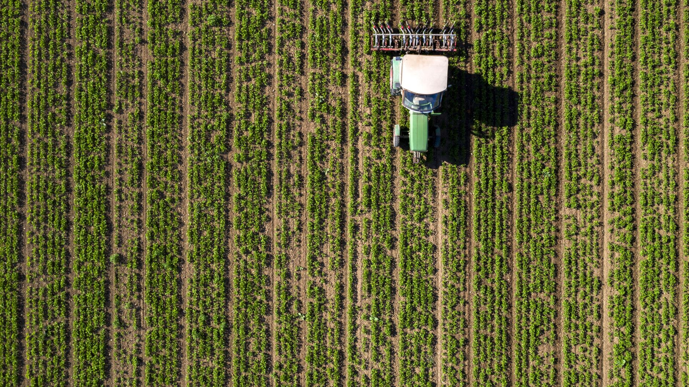
Automated Gardening System
-The Lazy Gardeners
Notes:
Chase Wikberg

Slide 2
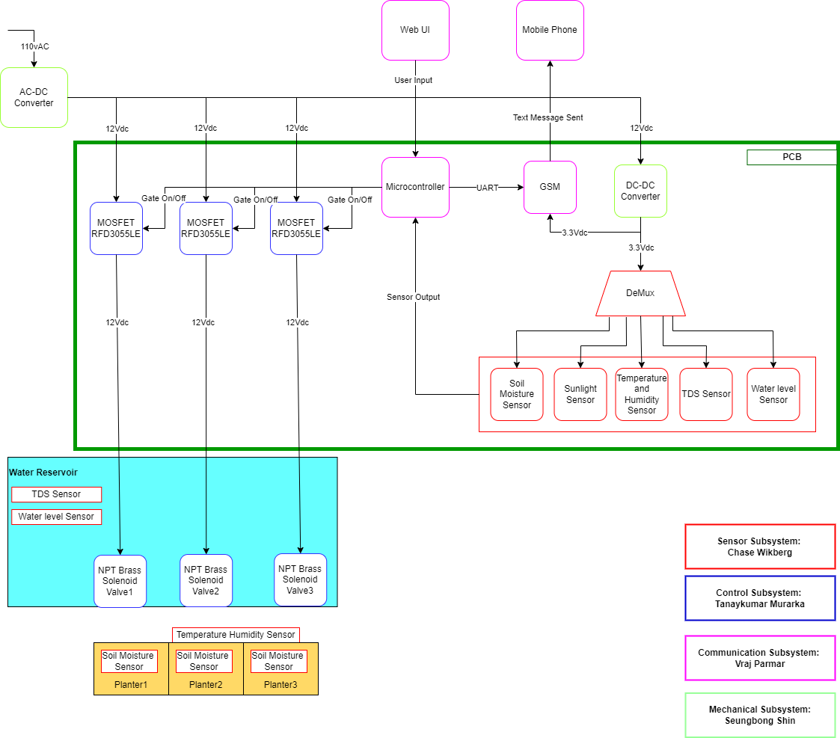
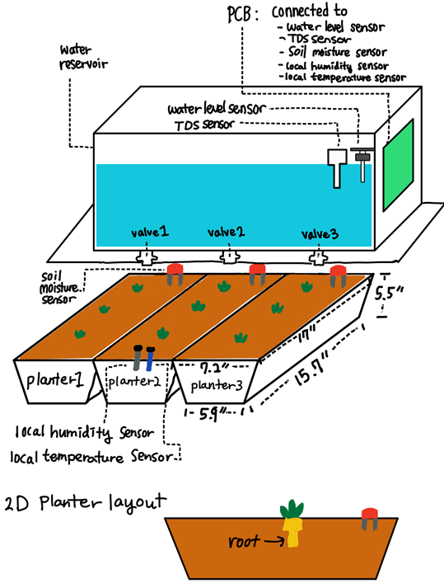
System Overview (Executive Summary, General Block Diagram, & Sketch)
Automated Gardening System for busy or inexperienced gardeners
Capable of maintaining several plant containers
Able to take in user preferences and monitor the plants in accordance with those preferences
Able to distribute water as needed to the various plant containers
Easy to use and understand

Slide 3
Sensors Subsystem
Chase Wikberg

Slide 4
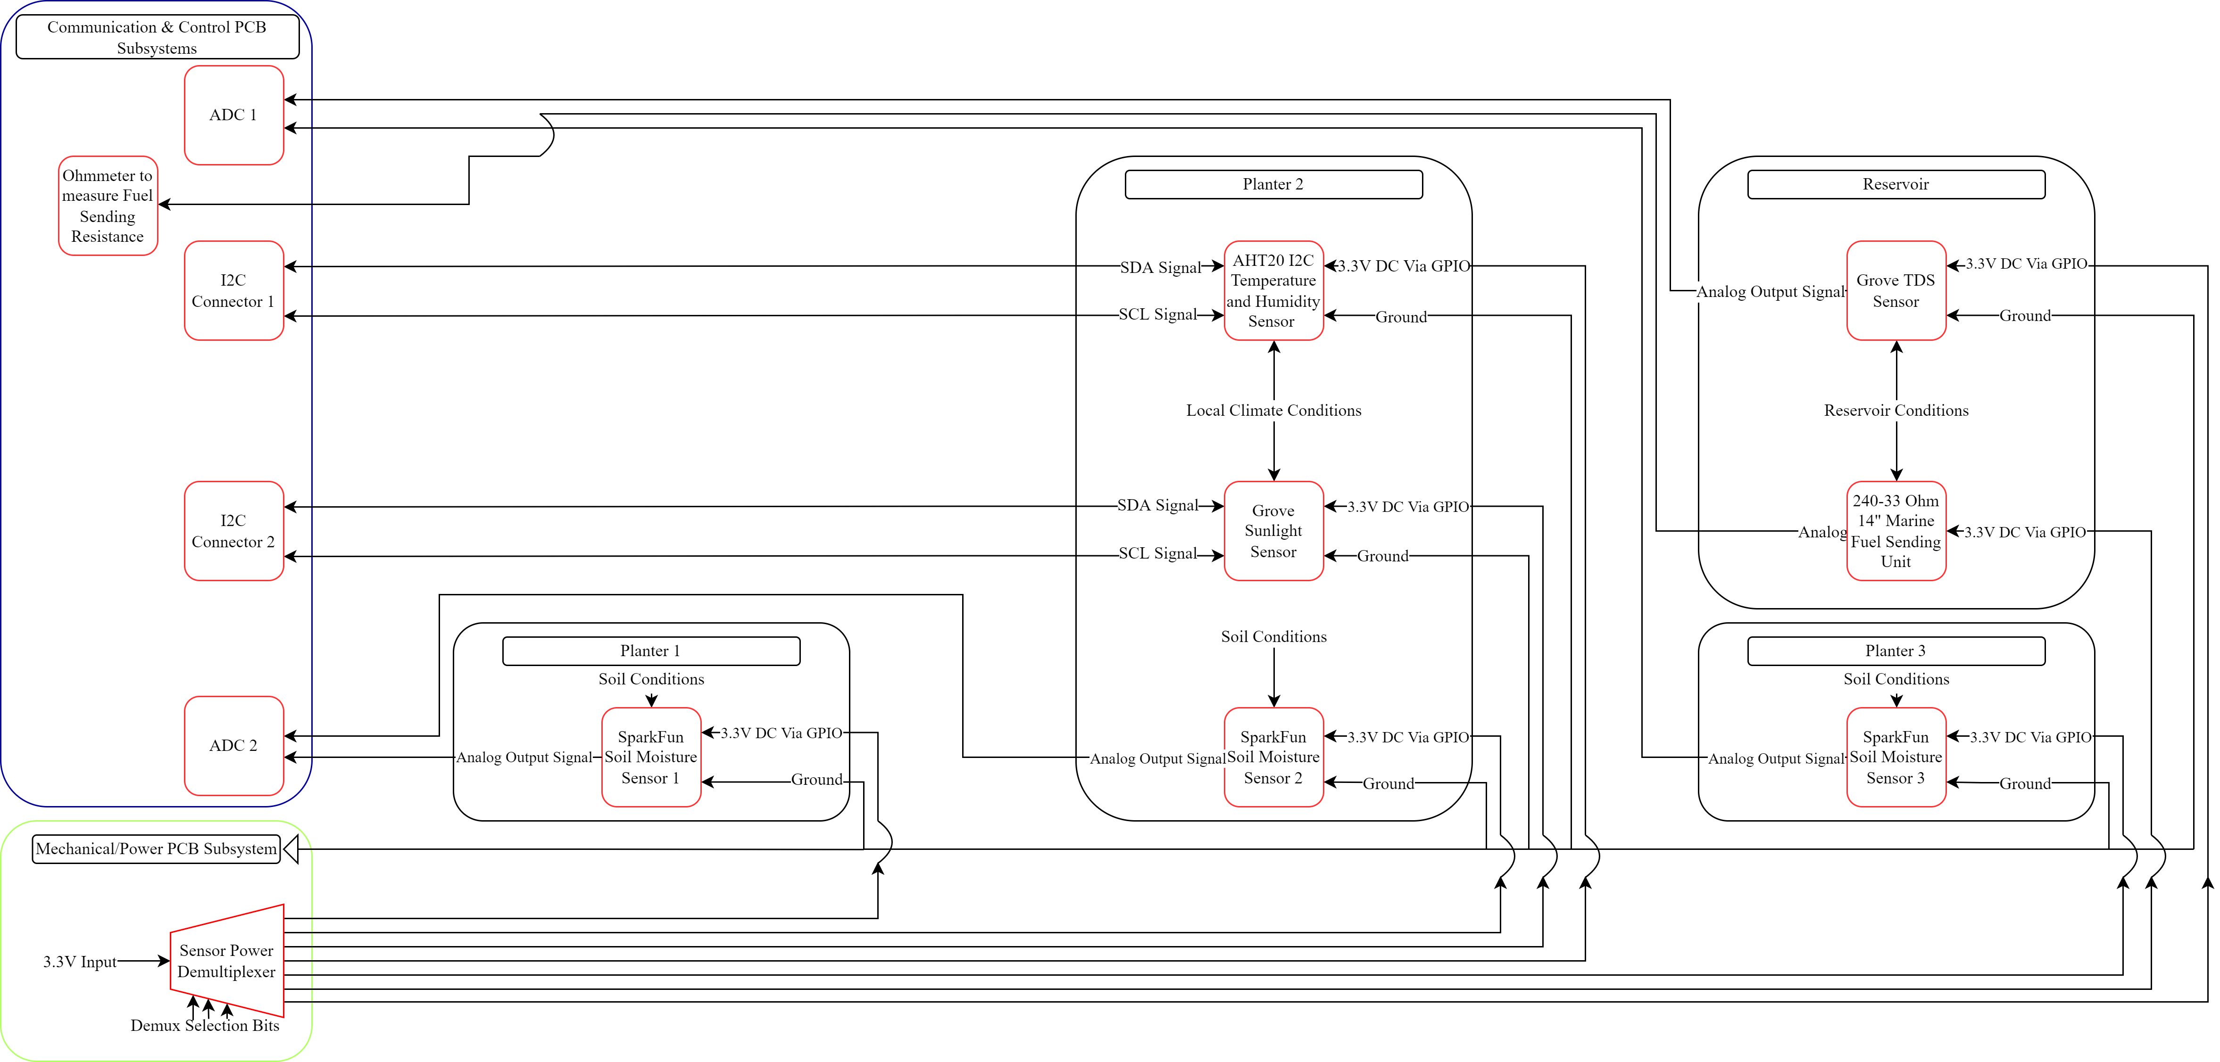
Subsystem Diagram

Slide 5
Must be able to receive data from sensors and adjust based on current “greenbox” conditions.
The device’s sensors must function on DC Voltage of no more than 5V. This is to ensure low power usage by the devices as well as uniform simple functionality and based on requirement 5.
Relevant Systemwide Requirements & Subsystem Specifications
Must be able to monitor soil moisture, water TDS level, local temperature, light level, and local humidity through web interface.
The device’s soil moisture sensor must be able to detect and report water saturation ranging from 0% to 100% saturation with an accuracy of ± 5 % saturation. The full range of water saturation is required because there are wide ranges of water amounts plants could require. This specification is based on requirement 8.
The device’s local temperature systems must be able to function in temperature ranges from at least -10 ºC to 50 ºC with an accuracy of at least ± 1 ºC. This specification is required because those are the extremes that any indoor device would experience. This specification is based on requirement 8.
The device’s local humidity sensor must be able to detect and report Relative Humidity ranging from 0 to 100% saturation with an accuracy of ± 5 % RH. This specification is required because those are the extremes of humidity that would be faced inside a building. This specification is based on requirement 8.

Slide 6
Relevant Systemwide Requirements & Subsystem Specifications Continued
Must be able to monitor soil moisture, water TDS level, local temperature, light level, and local humidity through web interface.
The devices sunlight sensor must be able to detect light from wavelengths 400 nm to 700 nm. As those are the wavelengths that chlorophyll is most effective at absorbing for use in photosynthesis. This specification is based on requirement 8.
The devices TDS sensor must be able to detect at least 1000 ppm in dissolved solids in water with an accuracy of ± 50 ppm. As that is the recommended amount of Total Dissolved Potassium and Nitrates present for providing new nutrients to the plants and soil. This specification is based on requirement 8.

Slide 7
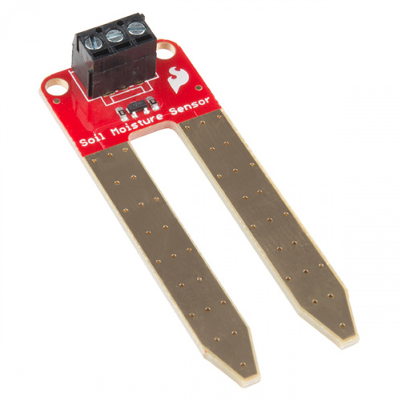
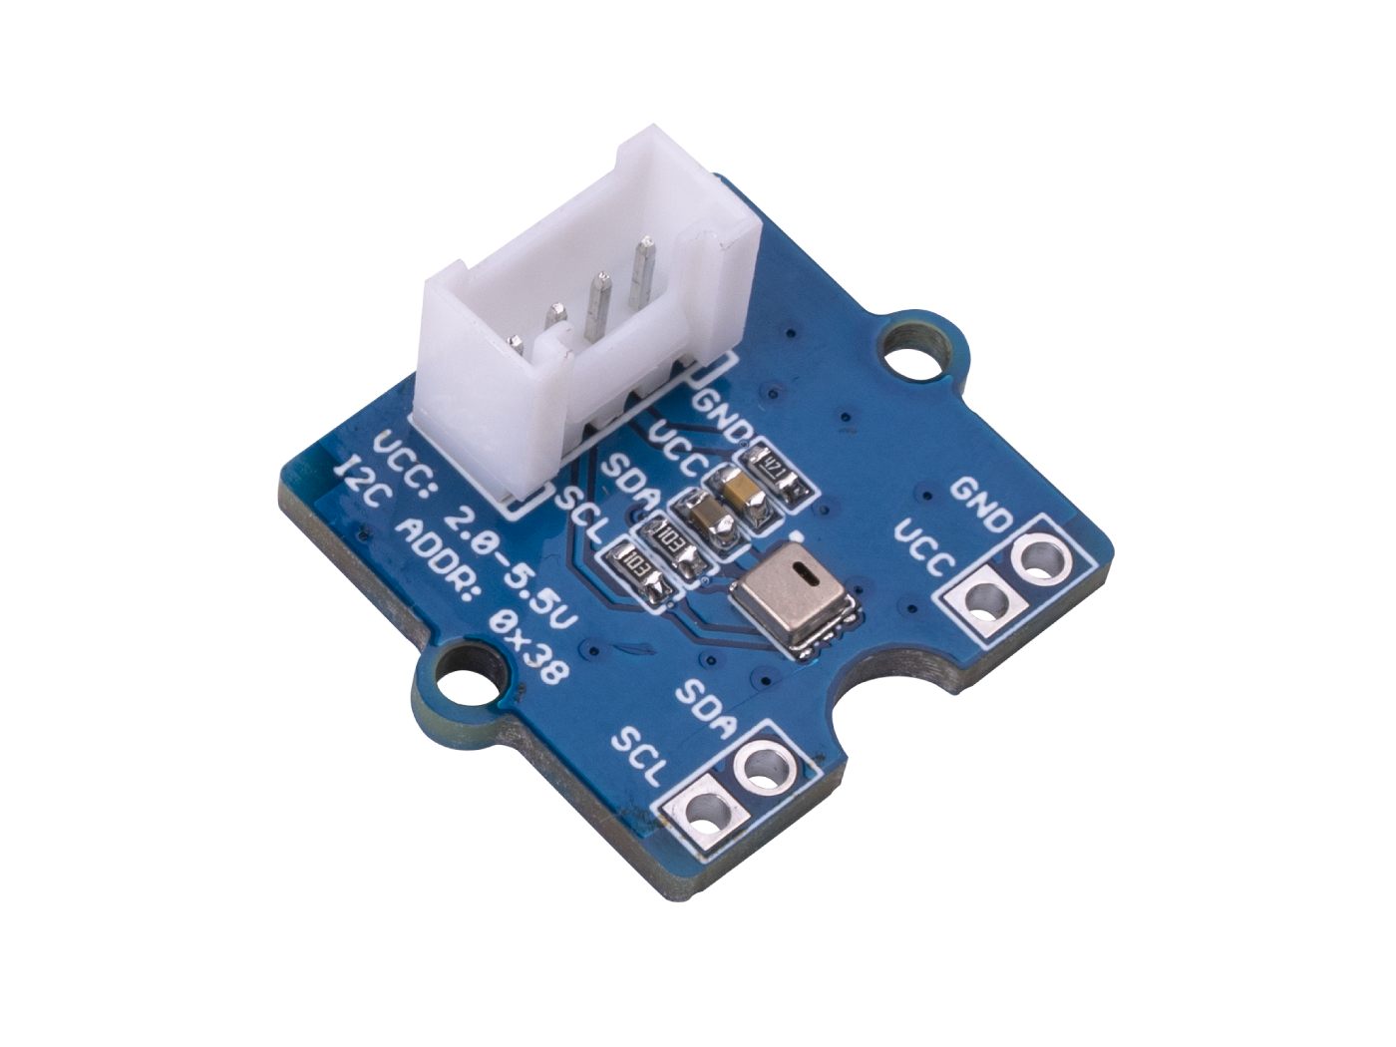
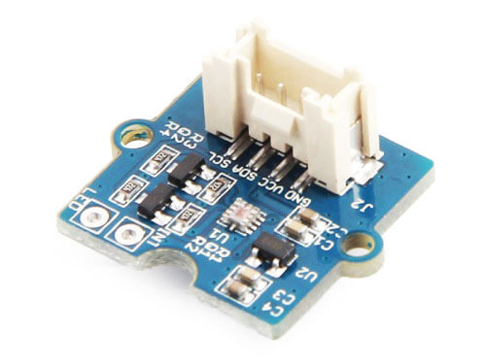
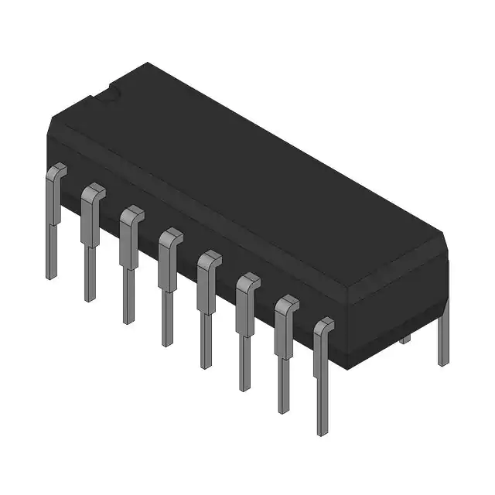
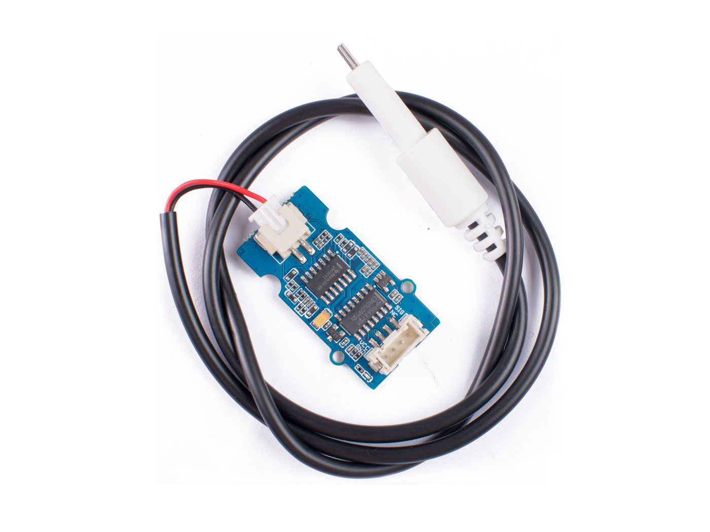
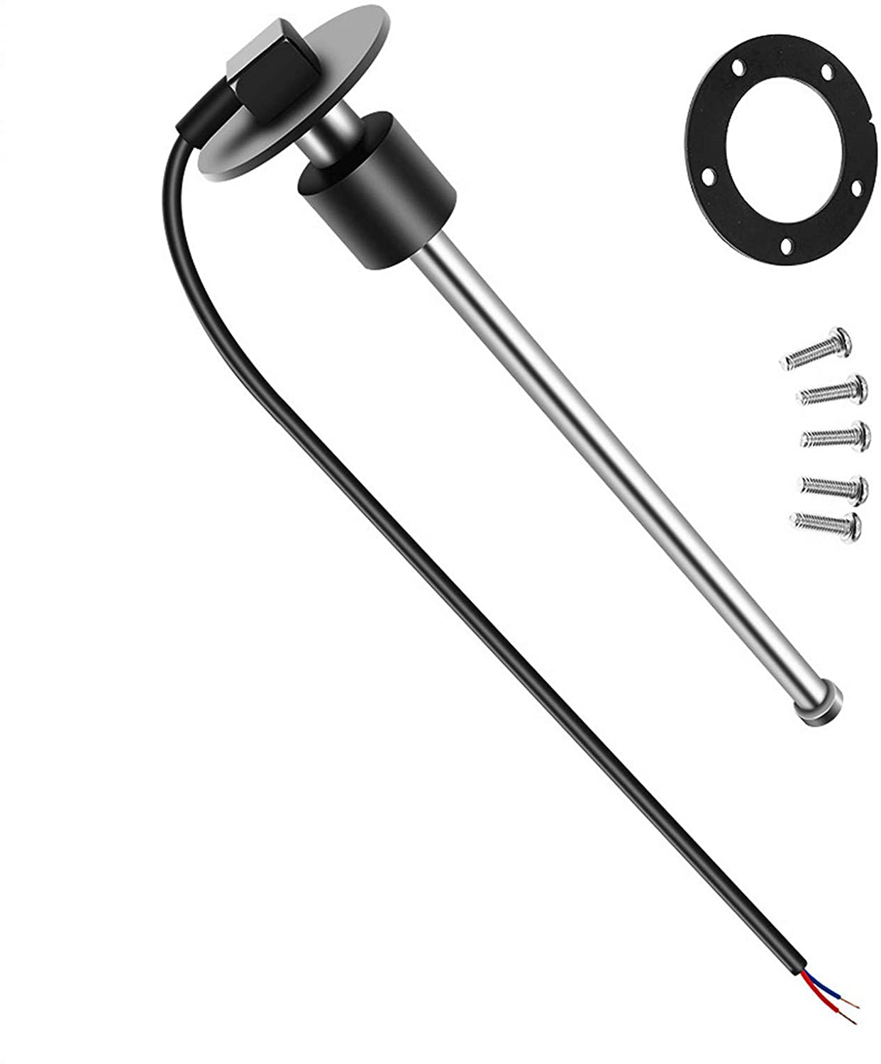
Subsystem Progress
Selected Components:
Sensors:
SparkFun Soil Moisture Sensor X 3 (To Be Ordered)
Grove AHT20 I2C Temperature and Humidity Sensor (To Be Ordered)
Grove TDS Sensor/Meter (To Be Ordered)
Grove Sunlight Sensor (To Be Ordered)
240-33 Ohm 14" Marine Fuel Sending Unit (To Be Ordered)
PCB Components:
SN74HC238A IC Decoder/Demux Chip (To Be Ordered)
100 Ohm resistor for FSU Ohmmeter (Already Owned from ECE 20007)

Slide 8
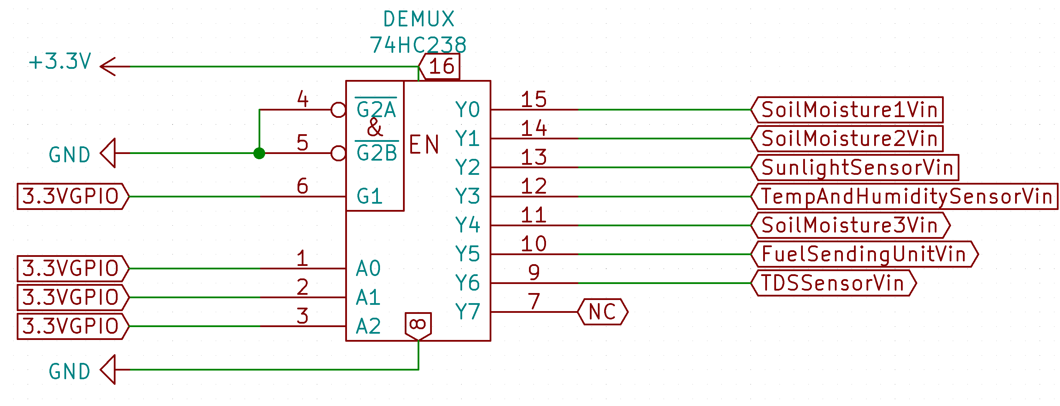
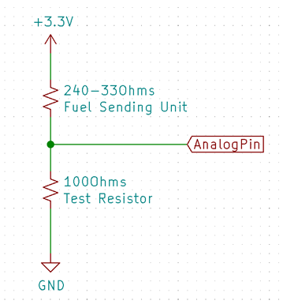
Subsystem Progress Continued
KiCad Schematics:
Demux Pinout Schematic
Ohmmeter Schematic

Slide 9
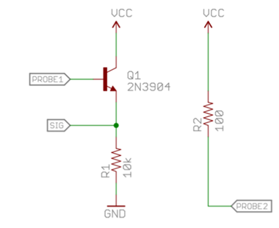
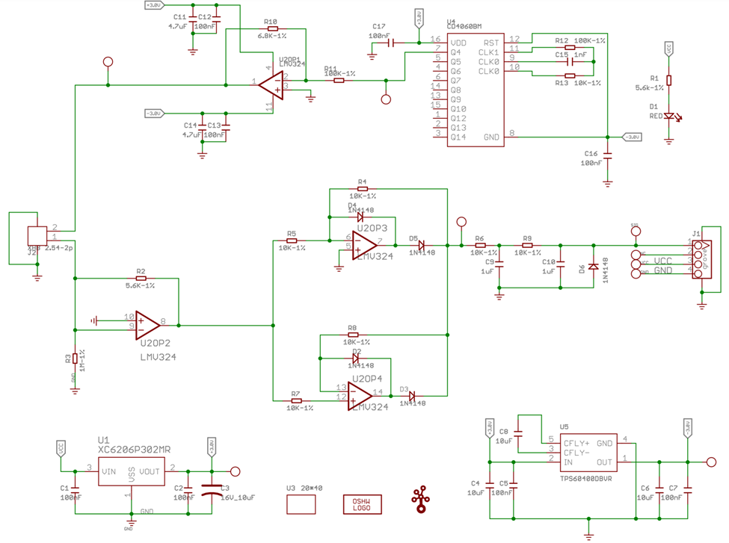
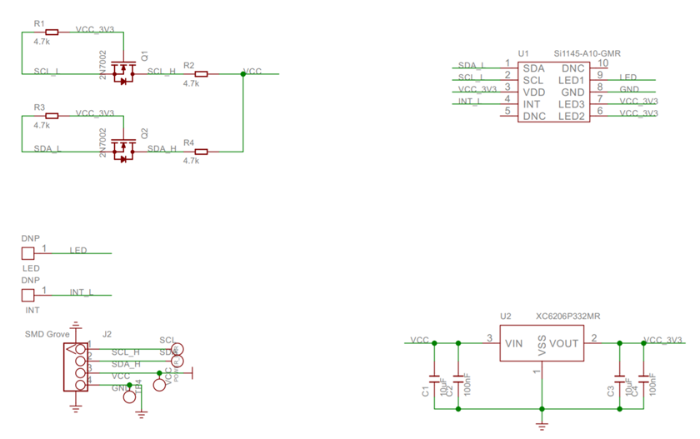
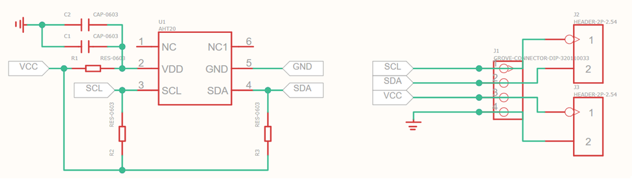
Subsystem Progress Continued 1
Grove TDS Sensor
SparkFun Soil Moisture Sensor
AHT20 Temperature and Humidity Sensor
Grove Sunlight Sensor

Slide 10
Subsystem Timeline and Plan
13 Feb. 2022
Complete component integration into overall PCB Design.
15 Feb. 2022
Begin I2C and ADC refamiliarization using ECE 362 course materials.
17 Feb. 2022
Receive component order and begin sensor testing.
22 Feb. 2022
Begin working with Mechanical Subsystem on sensor placement and mounting.
3 Mar. 2022
Midterm Demo of overall system.
5 Mar. 2022
Begin processing and implementing feedback on subsystem and overall device.

Slide 11

Controls Subsystem
Tanaykumar Murarka

Slide 12
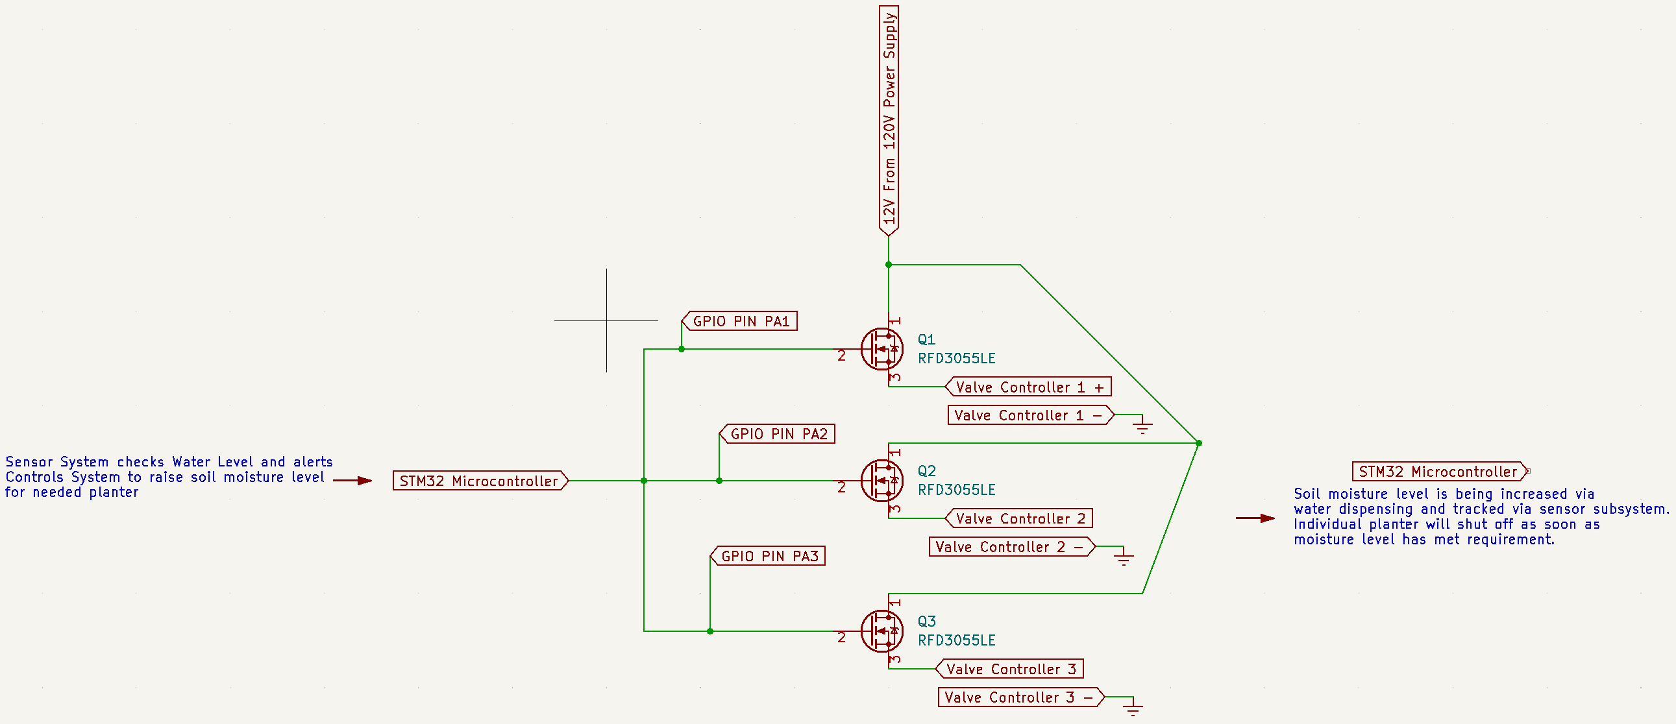
Subsystem Diagram

Slide 13

Subsystem Specifications
4. Must be able to distribute water automatically based on the preferences of the user for both soil moisture and time-based watering of the plants.
6. Must be able to monitor the conditions of and administer water to each plant container separately.
The valve controllers must open and close with the user specified soil moisture level or the “default” set moisture level in the web UI along with monitoring the water level to ensure there is water in the reservoir to change soil moisture.
Each valve controller must be working independent of each other so that if one subsystem of a planter breaks, it would not affect the other plants. Additionally, to utilize as low power as possible and for safety of the user, the “default” state for the valve would be off(no power)/closed.

Slide 14
Specifications Continued
6. Must be able to monitor the conditions of and administer water to each plant container separately.
The device must utilize a MOSFET for each planter to ensure safety for the user and the power draw of the valve being around 6 W each.

Slide 15

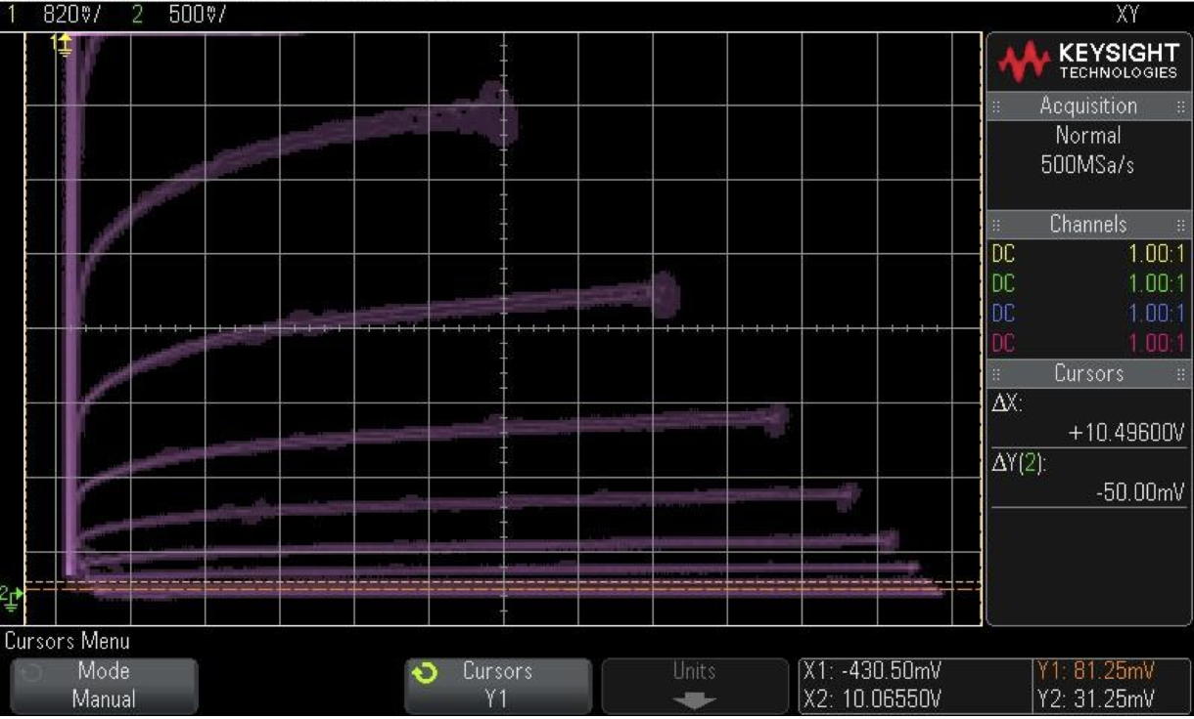
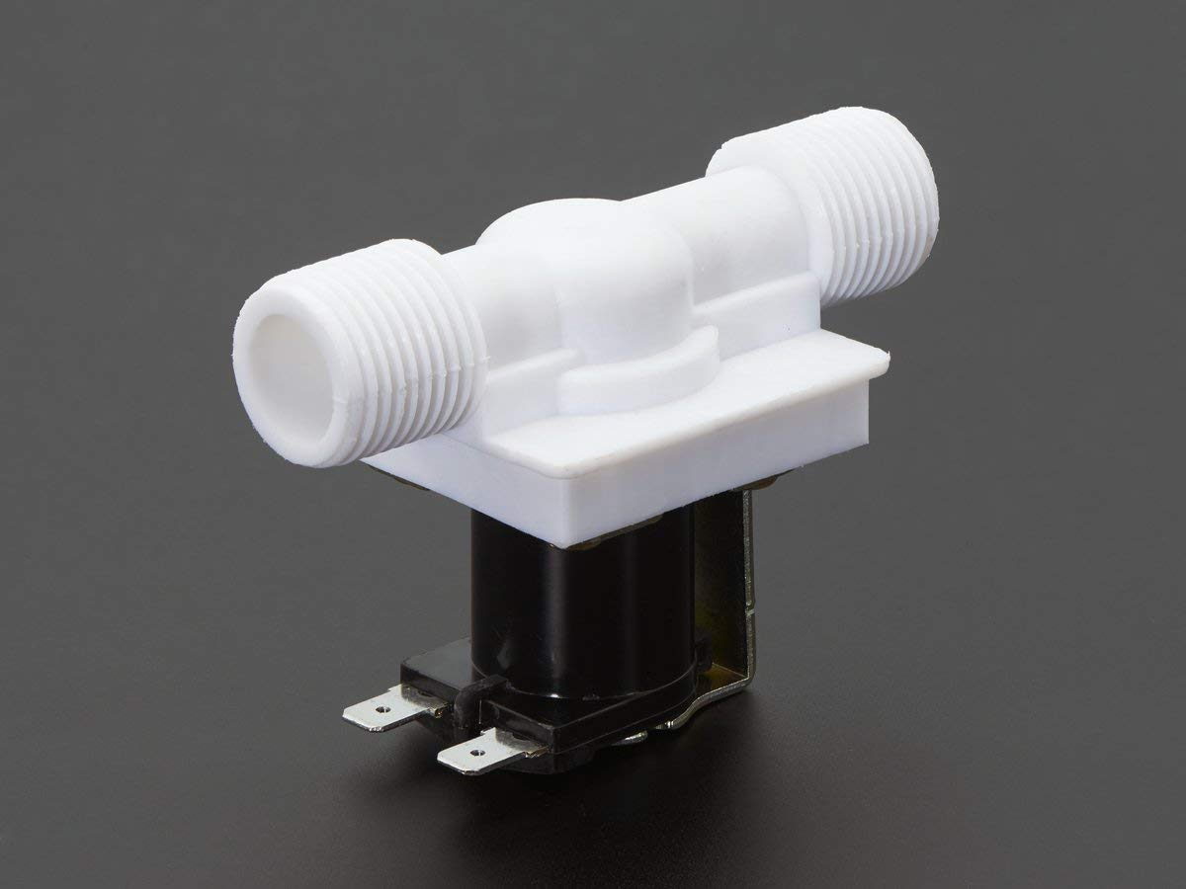
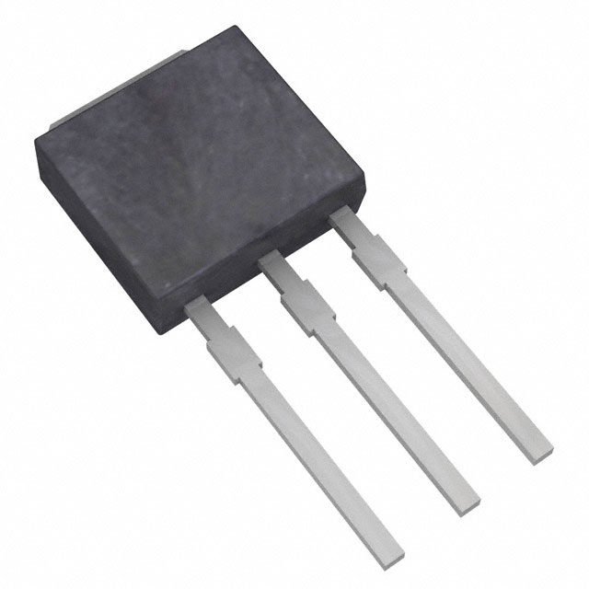
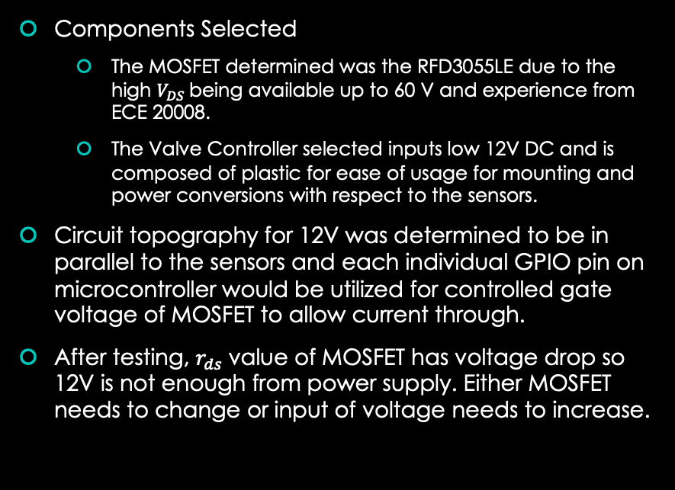
Progress
Components Selected
The MOSFET determined was the RFD3055LE due to the high $V_{DS}$being available up to 60 V and experience from ECE 20008.
The Valve Controller selected inputs low 12V DC and is composed of plastic for ease of usage for mounting and power conversions with respect to the sensors.
Circuit topography for 12V was determined to be in parallel to the sensors and each individual GPIO pin on microcontroller would be utilized for controlled gate voltage of MOSFET to allow current through.
After testing, $r_{ds}$value of MOSFET has voltage drop so 12V is not enough from power supply. Either MOSFET needs to change or input of voltage needs to increase.

Slide 16
Subsystem Plan
Complete overall PCB Design with communications system: 13 FEB
Begin importation of data and manipulation of valves using ECE 362 course materials: 17 FEB
Receive components order and begin valve testing: 18 FEB
Begin working with Mechanical Subsystem on valve placement and mounting: 22 FEB
DEMO: 2 MARCH

Slide 17
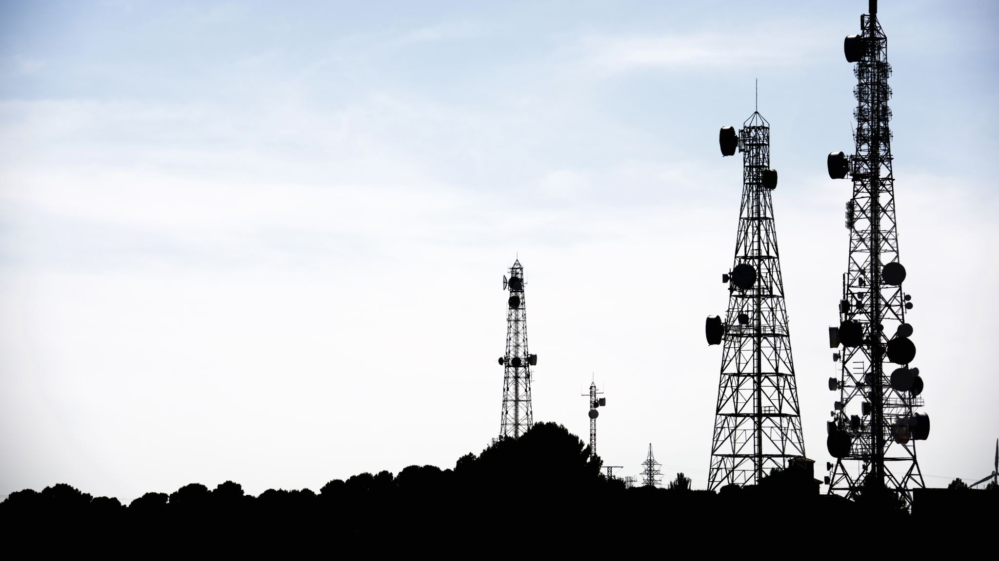
Communication Subsystem
Vraj Parmar

Slide 18
Subsystem Diagram

Slide 19

Subsystem Specifications
The user must be able to input their preferences for the plants in the most convenient manner from a web-based interface.
Focus would be put on the UI/UX design of the website, in order to provide the user with utmost ease when entering their preferences.
The Web User Interface also allows the user to add multiple plants with unique needs and preferences.
Ability to add preferences for more than one plant.
Make sure the GSM devices would be able to function at DC Voltage of no more than 5V.
Ensure low power usage by the devices as well as uniform simple functionality.
System must be able to notify the user when local conditions fall outside of their preferences using a text message.
GSM Device have been used which is connected to the microcontroller using the UART peripheral, to send a Text message to the user using the AT command Library.
An SQL database needs to be maintained, in order to store all user preferences.
an access to change these user preferences should be provided.

Slide 20
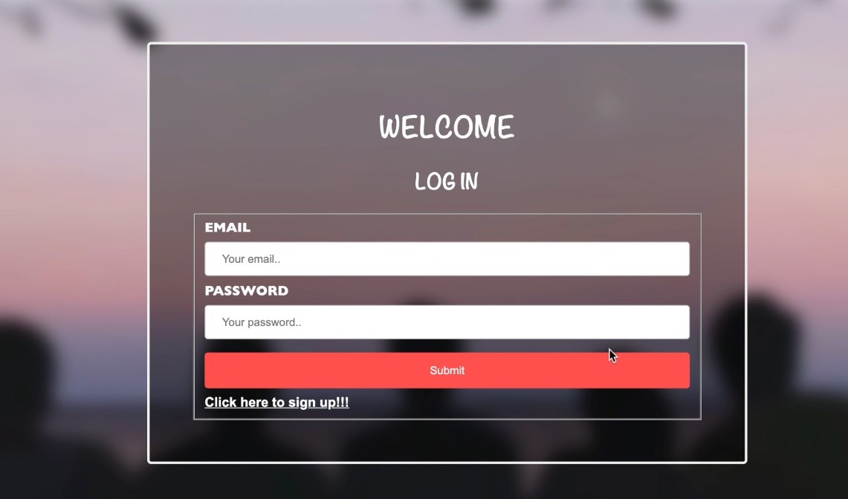
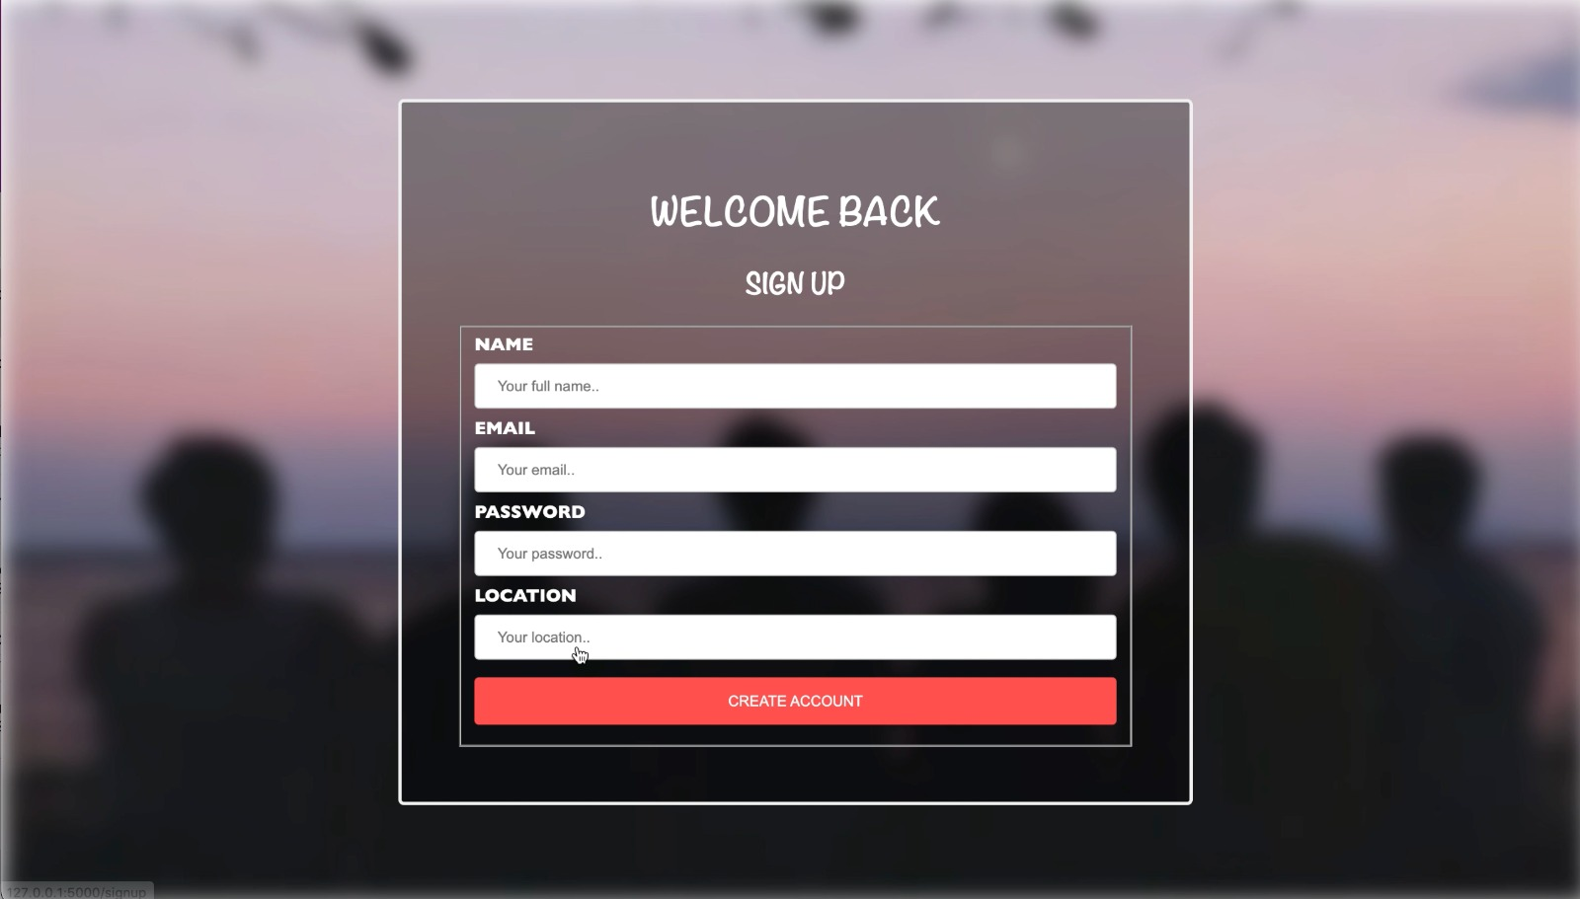
Subsystem Progress
Web Interface:
Construction of Web Interface have started. Login and Signup Page have been created. A database have also been setup to store user's, login credentials. In addition, python flask library have been used to RESTful API that connects the database to the frontend.
Deployment of Web Interface on cloud is in progress.

Slide 21
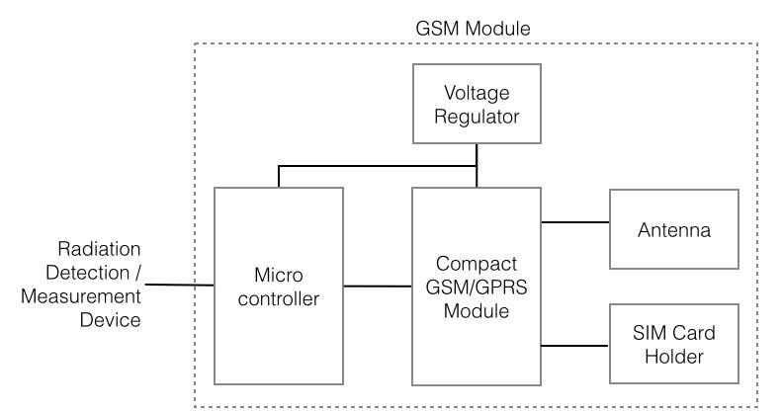
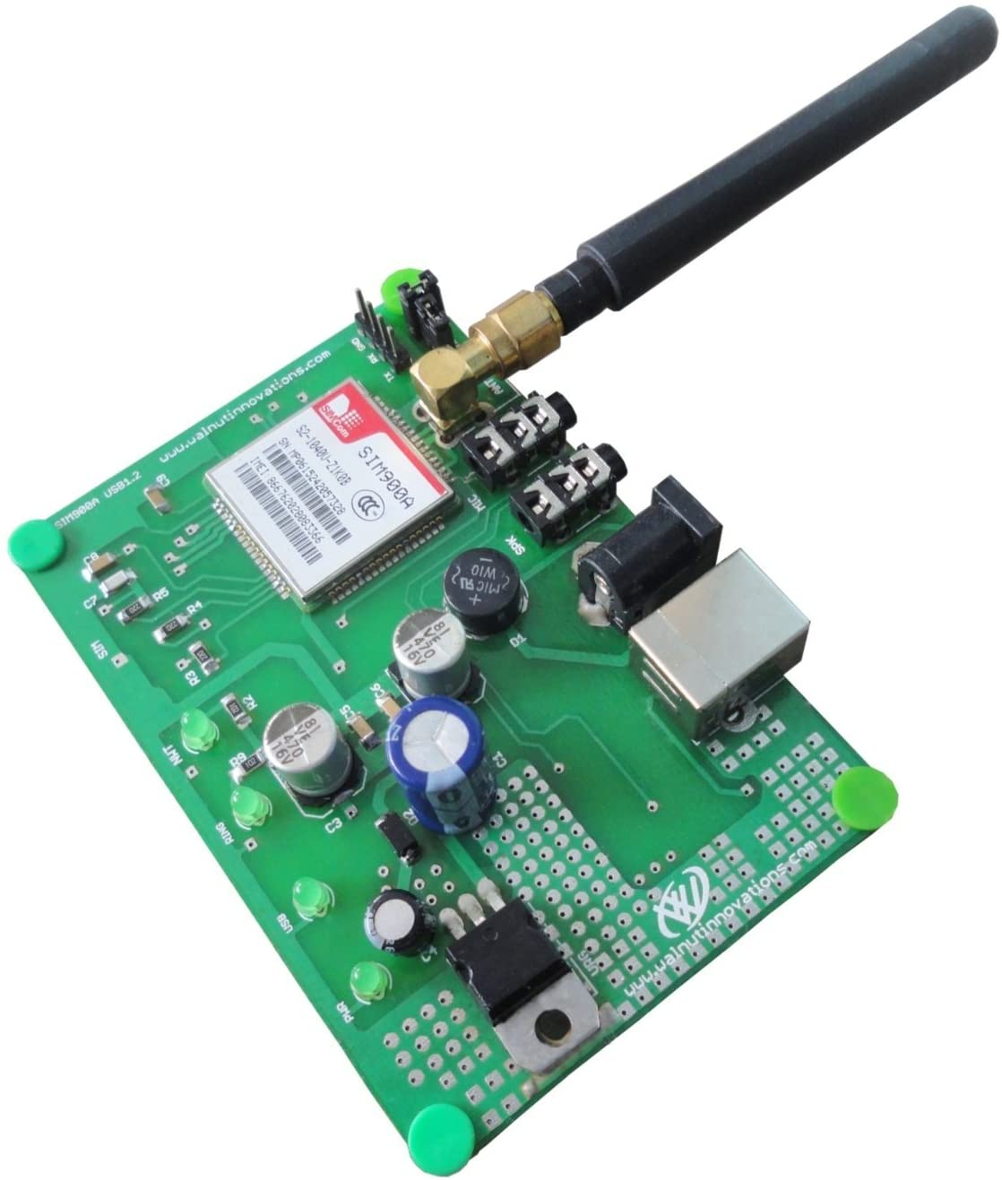
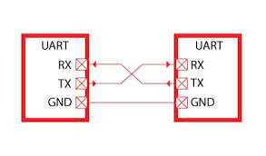
Subsystem Progress
Communication Channel Identified:
UART Peripheral.
AT Command library.
integrated TCP/IP stack.
Selected Components:
GSM device (SIM 800C)

Slide 22
Subsystem Timeline and Plan
15 Feb. 2022
Construct a working model of Web interface, that can let User login and add Plant Preference.
17 Feb. 2022
Complete UART refamiliarization using ECE 362 course material and research into TCP/IP Stack. Start working on importing user data to microcontroller.
22 Feb. 2022
Receive component order and begin GSM Device (SIM 800C).
24 March. 2022
Establish a communication channel between, user and "Green Box".
1st March . 2022
Testing overall subsystem.
3 Mar. 2022
Midterm Demo of overall system.
5 Mar. 2022
Begin processing and implementing feedback on subsystem and overall device.

Slide 23
Mechanical Subsystem
Seungbong Shin

Slide 24
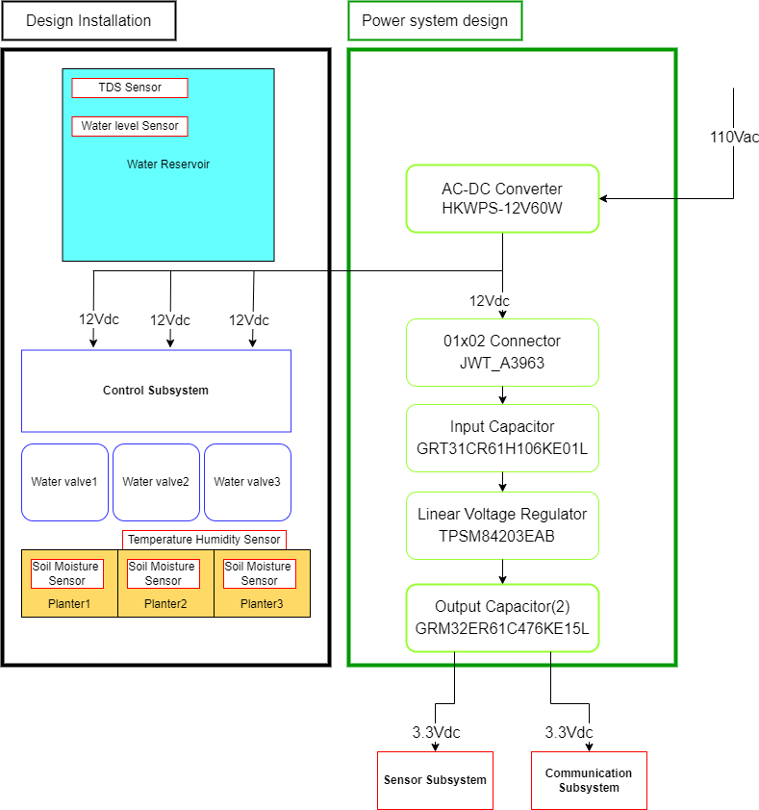
Subsystem design

Slide 25
Subsystem Specification
(Installation requirement)
1. Must have multiple containers to hold several plants with unique needs.
The planters must be sized deeper than 5”, which is sufficient for gardening vegetables.
Length of the water reservoir needs to be greater than 14”, which is sufficient for watering three 7” planters.
(Valve control requirement)
4. Must be able to distribute water automatically based on the preferences of the user for both soil moisture and time-based watering of the plants
HKWPS-12V60W converter must be generating 12Vdc and sufficent power for Solenoid valves, and it will be inputted to source of RFD3055LE MOSFETs, which is utilized for water automation

Slide 26
Subsystem Specification
(Sensor and communication related requirements)
6. Must be able to monitor the conditions of and administer water to each plant container separately.
7. Must be able to monitor the amount of water stored in the device and notify the user when it needs to be refilled.
8. Must be able to monitor soil moisture, water TDS level, local temperature, light level, and local humidity through web interface.
HKWPS-12V60W converter must be generating 12Vdc for dc-dc converter that is utilized to power the sensors on PCB
DC-DC converter must be generating 3.3Vdc, which is desired inputs for the sensor subsystem and communication subsystem.
10uF input capacitors and 47uF capacitors are necessary to smooth the voltage and act as a reservoir of energy flowing to the output.
TPSM84203EAB Linear Regulator needs to be operating as expected to generate 3.3Vdc output with the correct pin connections.

Slide 27
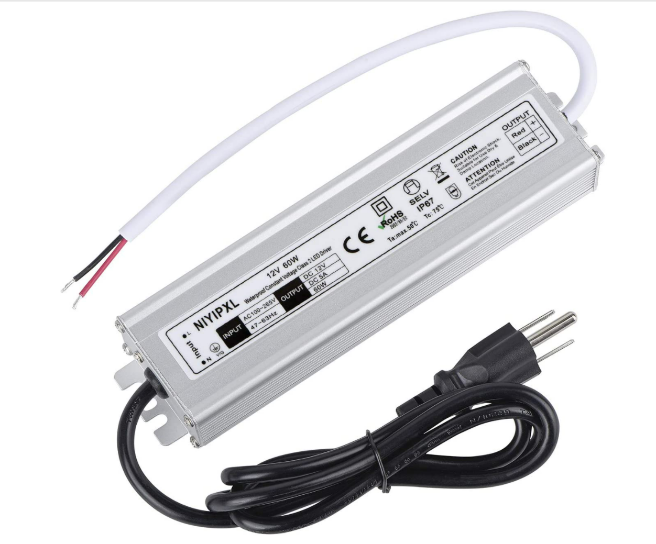
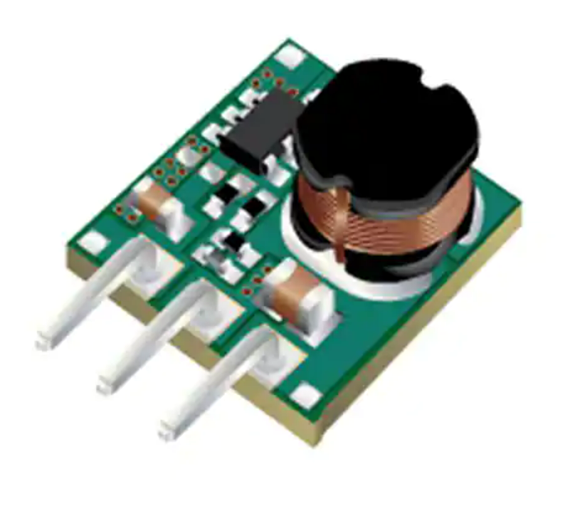
Subsystem Progress
(1) AC-DC converter
Selected Components:
HKWPS-12V60W₍₁₎ is a AC-DC converter outputs 12Vdc
DC-DC Converter
JWT_A3963 : 01x02 Male Connector
TPSM8420EAB : linear regulator₍₂₎
GRM32ER61C476KE15L : Output Capacitor
GRT31CR61H106KE01L : Input Capacitor
Planters and water reservoirs
B07VD55NMT planter with 7.2”Lx17”Wx5.5”H
28 Quart Waste basket 10.5”Lx14.25”Wx15”H
(2) Linear voltage regulator

Slide 28
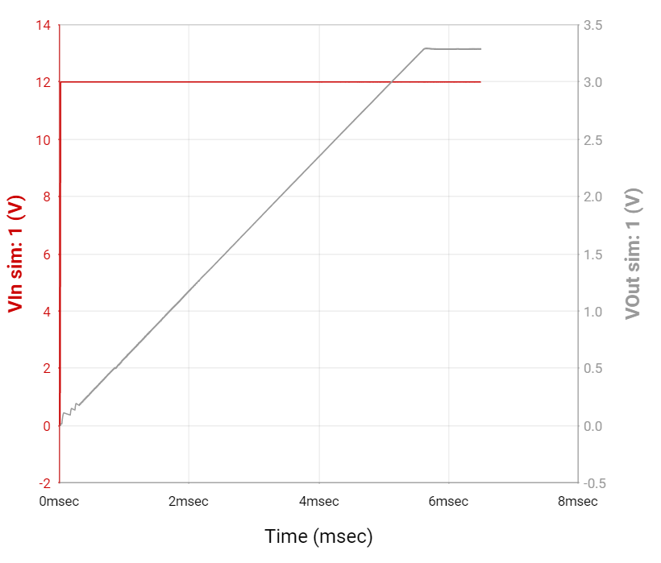
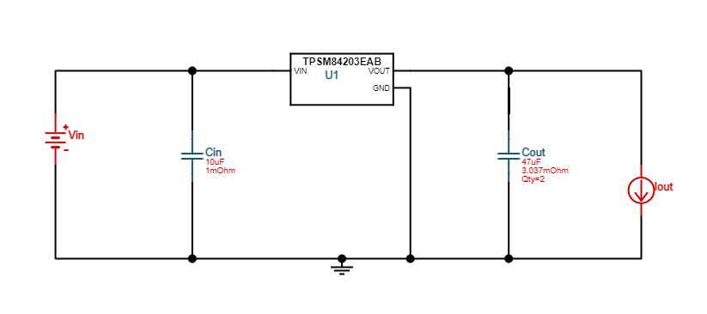
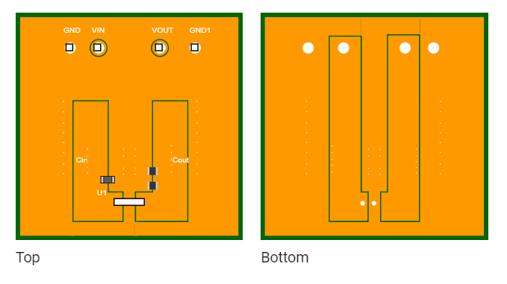
Subsystem Progress
(3) Vout vs. Vin Simulation
DC-DC Converter with TPSM8420EAB is designed through TI Webench Power Designer
With the efficiency(Vout/Vin) of 91.1%₍₃₎
Simulated output voltage shows the desired output of 3.3Vdc
Minimum BOM count of 4
Cost efficient with $10
Simple Schematics, easy to apply on PCB design software₍₄₎
(4) TI Schematic
(5) TI PCB layout

Slide 29
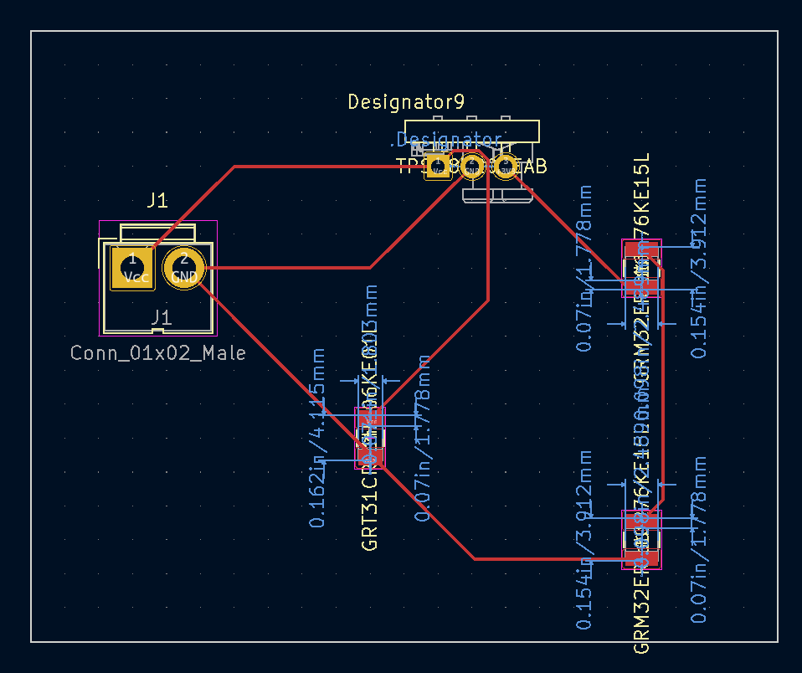
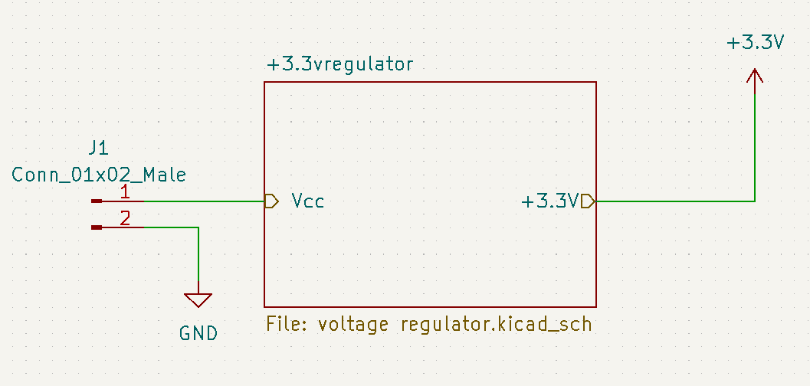
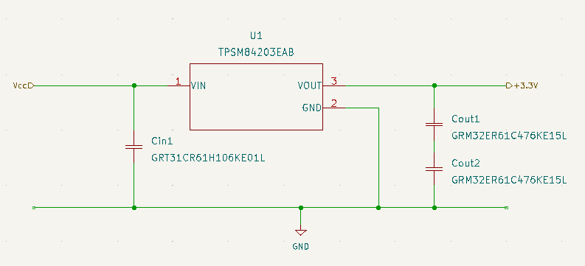
Subsystem Progress
(8) PCB design on KiCAD
KiCad Design
Hierarchical design₍₆₎ is used to simply interact with other subsystems
Created the recommended power system by TI webench on KiCAD₍₇₎
CAD models and footprints are imported and added to the library
Components in schematics is assigned to equivalent footprints
Designed PCB equivalent to the schematic₍₈₎
(6) Hierarchical design
(7) KiCAD DC-DC converter schematic

Slide 30
Subsystem Timeline
14 Feb.
Complete PCB subsystem design that
Generates expected output voltage in spice simulation
Output of this subsystem needs to be parallelly connected to other subsystems in spice simulation
24 Feb.
Progress check 3, get the ordered components
Test the AC DC converters and electronic components on breadboard
Install sensors
3 Mar.
Midterm demo
PCB subsystem simulation
Design on the breadboard
Design set-up plan
8 Mar.
Complete PCB system as a whole design that generates ideal outputs in simulation

